Slide 1
Level Crossing Programme Update
Transport and Infrastructure Committee
21 September 2023

Slide 2
Level Crossings – Outcomes and forward plan
Grade separation of all level crossings in the Auckland region – currently unfunded ($1.3b in 1st 10 years and ~$3b overall tbc through PBC)
3
1. Improving safety (system wide)
2. Network efficiency (Takaanini group) currently unfunded ($642m)
2
1. Improving safety (system level); $70m programme for AT = 6x closures
2. Network efficiency (in CRL loop) = 3x closures delivered by CRLL
1
Day 1 2031 2046

Slide 3
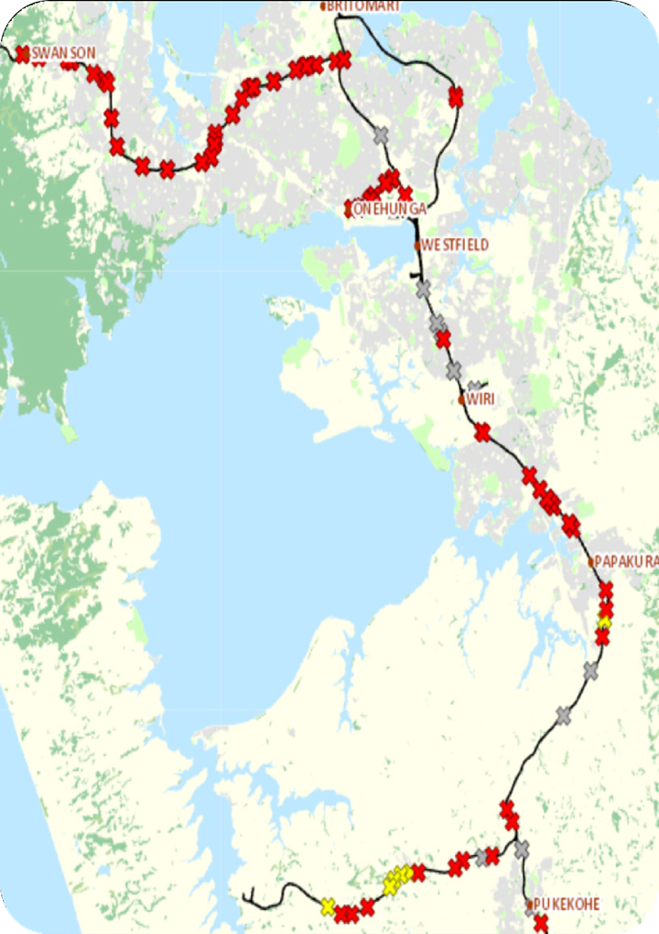
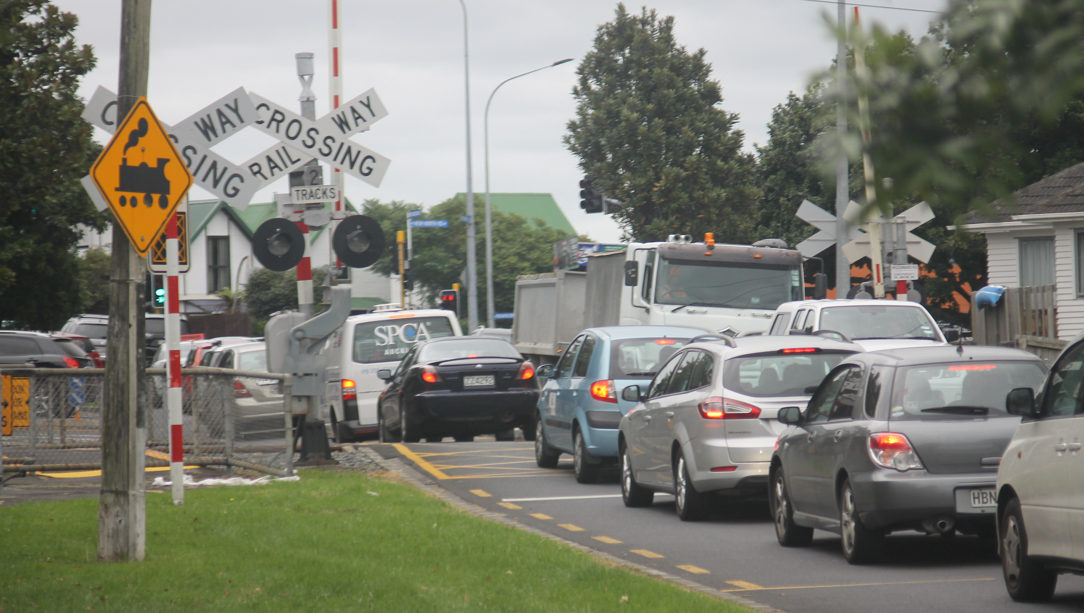
Level Crossings - Overview
The case for closure / grade separation
49 crossings with rail and roads or footpaths cross at the same level.
This interface poses a safety risk of collision and serious harm.
Safety risk increases as usage of the crossings increases as a result of population growth, traffic growth and increases in train services.
Road network efficiency reduces with barriers down for longer times.
Crossings have highest level of protection available under KiwiRail standards - Half Arm Barriers, Flashing Lights and Bells – but incidents still occur.
CRL progressed without level crossing mitigations.
AT and KiwiRail desire to remove or grade separate ALL level crossings to eliminate risk - challenging and potentially contentious and will take time.
Funding for a full removal programme has yet to be confirmed - unlikely to be affordable for Auckland under the current funding approach.
Current focus is on continuing to mitigate risk prior to CRL Day 1.

Slide 4
Incident History
Data collated by AT train operator September 2013 – 2023:
Motor Vehicles
7 vehicle collisions and 11 Near Misses (2 of those at Church Street East).
11 level crossing barrier arms are struck by vehicles each month, demonstrating the frequency with which driver’s mis-use level crossings.
Pedestrians
561 pedestrian near misses across the network:
239 at level crossings.
55 Near Misses at pedestrian level crossings with automatic pedestrian gates.
53 Near Misses occurred in our CRL Day 1 removal programme.
Data from Waka Kotahi and Coroner’s Office 2013 – 2023:
17 fatalities on the Auckland Rail Network:
10 at level crossings and 7 at stations or in the rail corridor.
Ages range from 12 to 74.

Slide 5
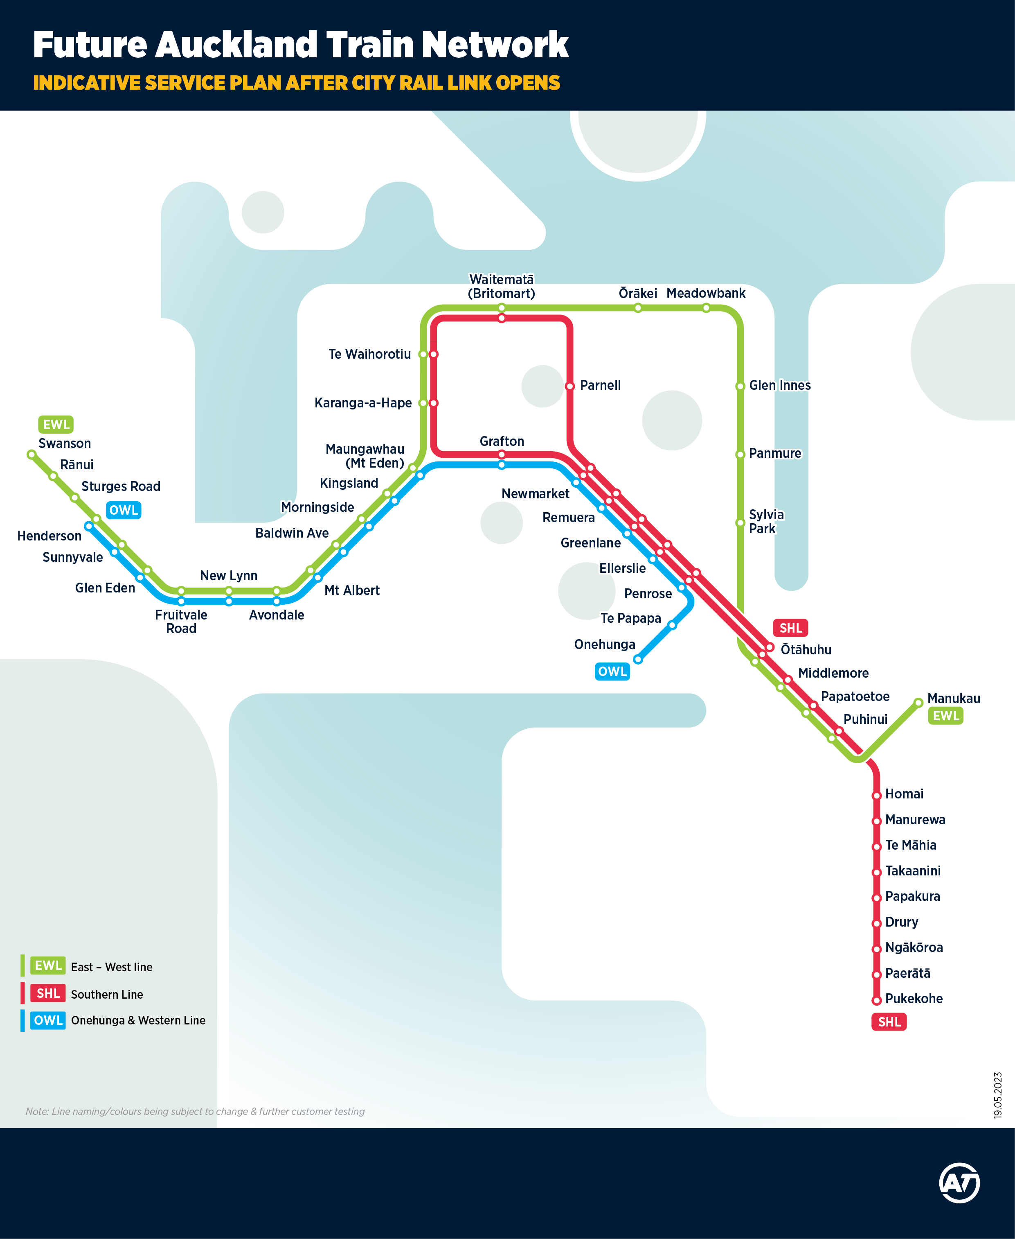
Planned Changes to Rail Services
CRL ‘Day 1’ timetable
Opening of the CRL tunnels will enable higher frequency rail services.
Freight services are also expected to increase, along with the potential for more inter-regional services.
This increases the statistical risk at Level Crossings.
It will also lead to more frequent and longer operation of level crossing barriers in some locations.
A formal process is underway with Safety Case holders (Auckland One Rail and KiwiRail) and the Regulator (Waka Kotahi) to assess risk and finalise the detailed operational timetable.
A version of this timetable has been developed that will help mitigate this risk if required.

Slide 6
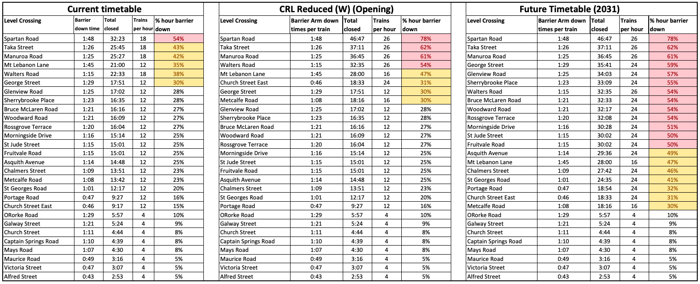
Do nothing: barrier arm closure time at peak (current estimates based on previous timetable monitoring)
1
2
3
1
The Current timetable shows barrier down times for today’s timetable.
This is the current estimated impact of the timetable at CRL opening, subject to rail modelling and road network operations assessment
The 2031 future timetable is an estimated impact of the timetable of up to 16 trains operating through CRL and to the full extent of the network in both directions, subject to rail modelling and road network operations assessment
2
3

Slide 7
Mitigations
Work completed or underway for CRL Day 1
Locking gates at all pedestrian crossings.
Removal of 3 crossings by CRLL.
Removal of Church Street East Level Crossing – last road crossing on the inner network.
Removal of 5 pedestrian crossings.
Grade Separation of Homai Station access.
Updated risk assessments of all crossings to identify any other feasible mitigations, in conjunction with KiwiRail and the Regulator .
Detailed Business Case for Removal of 4 level crossings in Takaanini – Notice of Requirement subject to consultation.
PBC for all remaining all crossings.

Slide 8
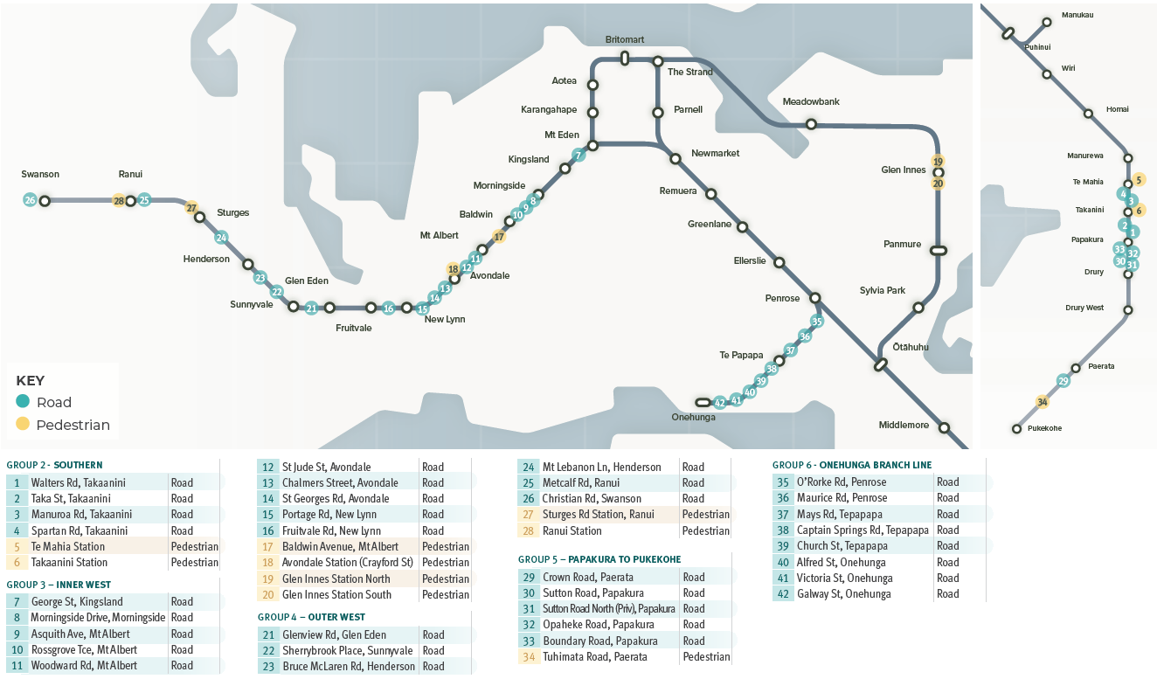
Mitigations
Long term programme
Progressively remove remaining crossings.
Programme development underway via PBC to confirm risk-based prioritisation and funding.
Draft GPS identifies level crossings in Auckland and Wellington as part of the Strategic Investment Programme.
Programme will be progressed jointly with KiwiRail and will require close engagement with Waka Kotahi as Funder and Regulator.
4 Southern Line level crossings in Takaanini at Day 1 CRL will have increased barrier arm downtime of between 54% and 78% peak hour.
Business cases for funding are being finalised.

Slide 9
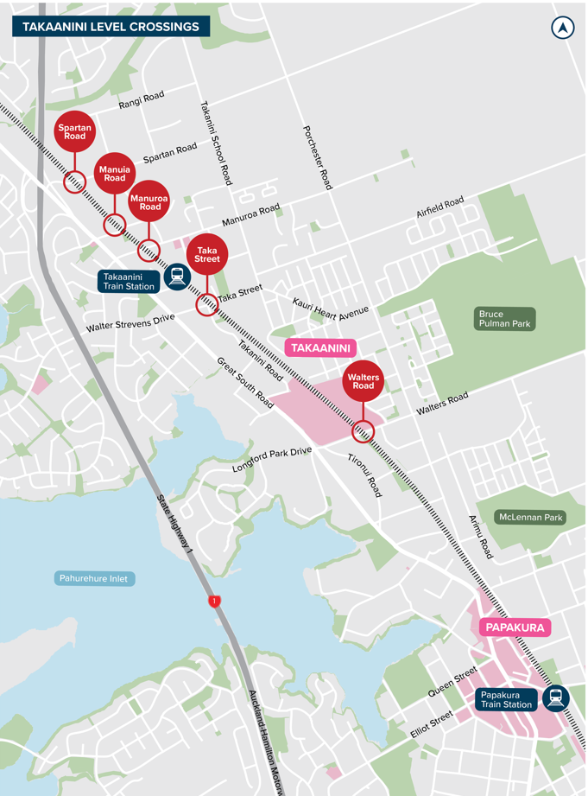
Prioritisation
2014 risk-based assessment to identify priorities
Prioritisation based around barrier down time, practicality and funding
Southern Line around Takaanini highest priority
ATAP funding sought 2016-2018 not confirmed
Funding secured via Supporting Growth Alliance for DBC – nearly complete
Prioritisation of the remaining crossings tbc via Single Stage Business Case, due by December
Broad prioritization via existing Groupings:
Takanini Group highest priority
Onehunga Line lowest priority

Slide 10
Prioritisation
Options at each site will be assessed against the following criteria:
Investment Objectives
Safety
Level Crossing Safety Impact scoring
Impact on efficiency of transport network
Train Operations
Traffic Operations
Community severance
Pedestrian / cycle accessibility
Vehicle accessibility
Value for money (BCR)
Opportunities to integrate with adjacent projects

Slide 11
Funding
Level Crossing Group | Funding requirement | Status
Group 1 | $63m | $12m confirmed in FY24. $51m proposed for FY25 – FY27
Group 2 – 6 | c. $3.0bn | Takaanini grouping (Group 2) ~$642m unfunded in 10-year LTP period Rest of level crossings: ~$1.3bn unfunded in 10-year LTP period ~$1b post-10 year LTP period to total ~$3b estimated amount tbc in Single Stage Business Case.

Slide 12
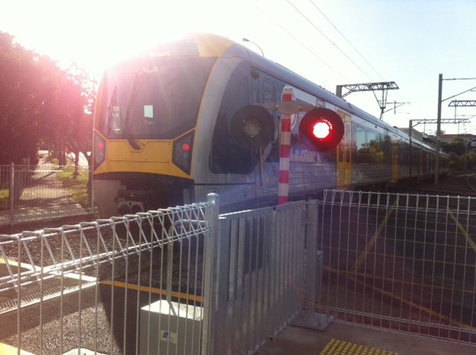
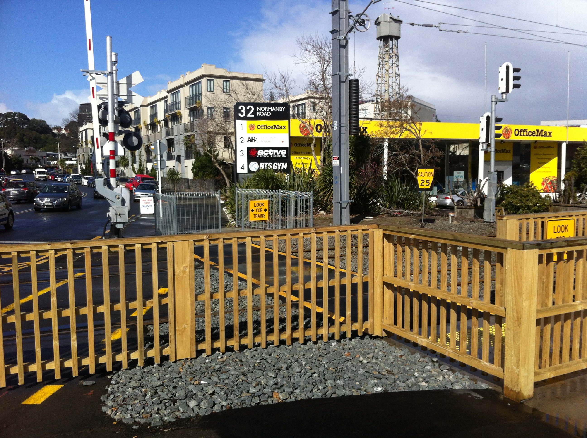
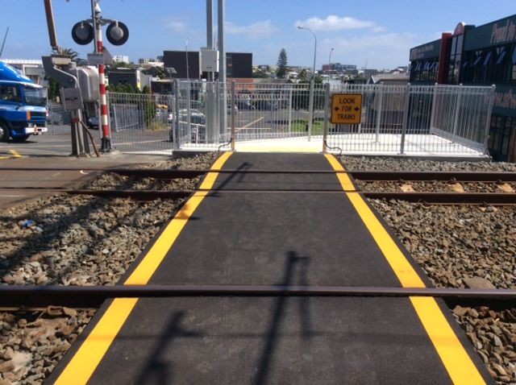
Next Steps
Complete CRL Day 1 mitigations: inner network road crossing removal and some pedestrian crossings, complete automatic gates at all pedestrian crossings.
Complete update of risk assessments at all crossings to inform further system wide risk review and further CRL Day 1 mitigations.
Continue engagement with Safety Case Holders (Auckland One Rail, KiwiRail) and Regulator (Waka Kotahi) to confirm mitigations and CRL timetable.
Complete Business Case and define programme for long term removal of all level crossings.
Engage with Council and Government to secure funding commitment through LTP process.

