Slide 1
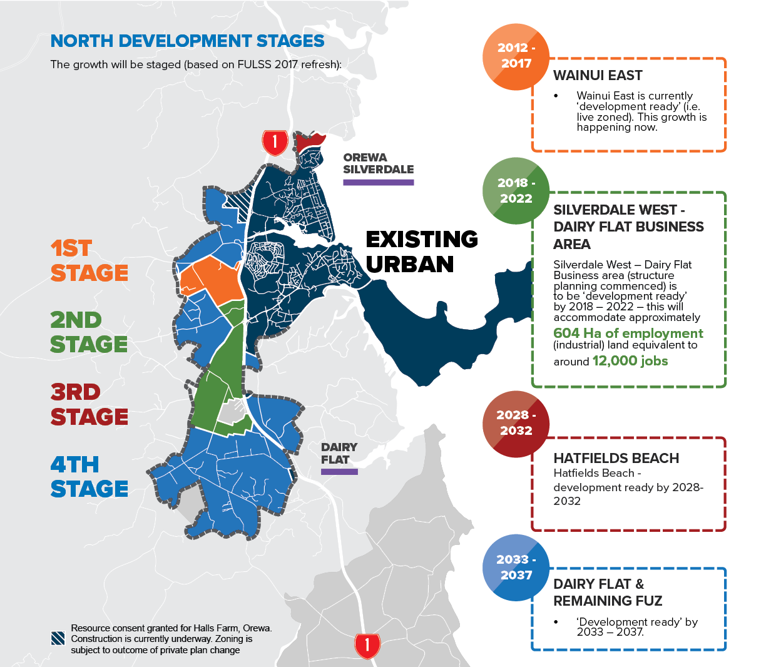
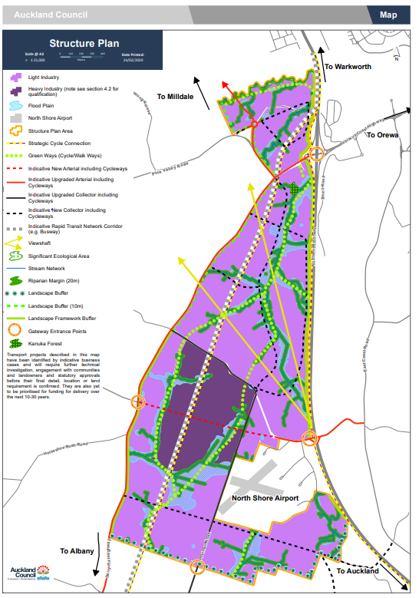
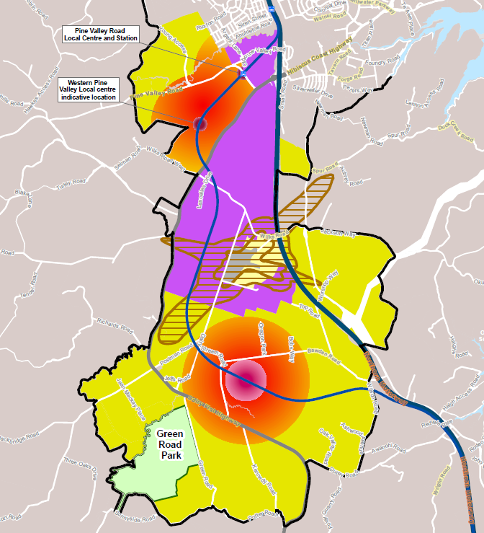
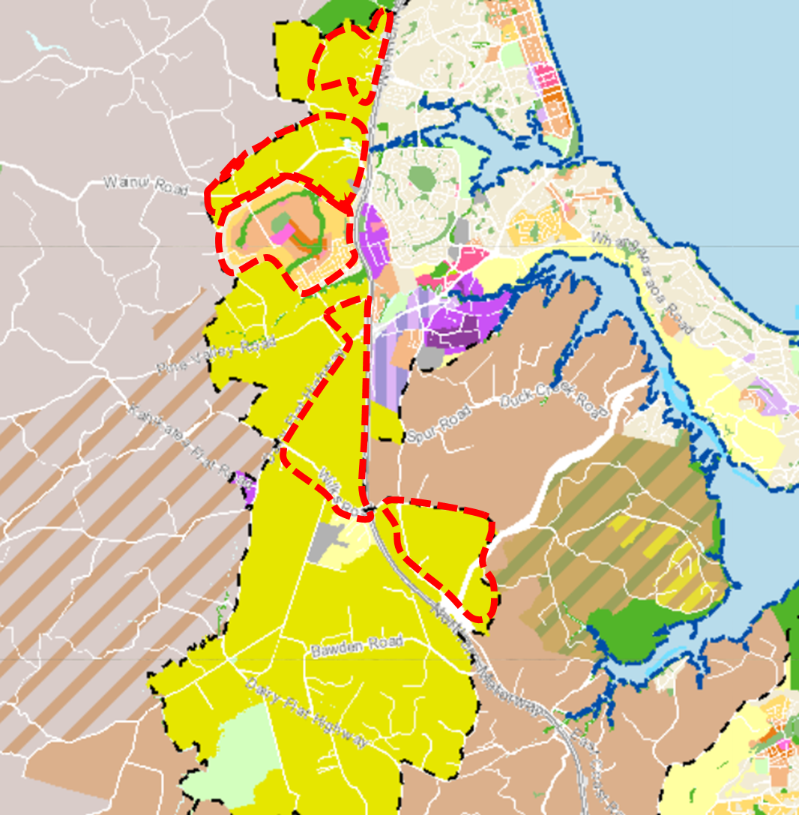
Attachment 1:Council’s changing vision for growth in the North
Future Urban Land Supply Strategy
Silverdale West Structure Plan
Draft Spatial land use strategy 2022
Plan change / developers acquisitions 2023
Draft Future Development Strategy 2023
Slow down further investigation
needed
  Growth
  41,000 additional households, 22,000 additional jobs, 110,000 additional people. A three-fold increase to existing population.
Proposed private plan changes and consent applications (RED) increasing pressure to bring forward land release ahead of FULSS timing (2033-37).
  Vision
Industrial area providing much needed land for business and local jobs
Large town centre in Dairy Flat integrated with the RTC
Connectivity between centres

